Slide 1
Lecture 11

Slide 2
The delivery of this lecture was recorded.
You may wish to listen to the recording as you read these slides
The recording is here:
  http://www.cs.ucc.ie/j.bowen/cs4408/period2/talks/lecture10.mp3

Slide 3
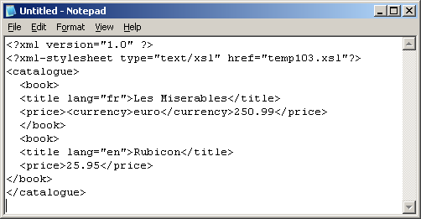
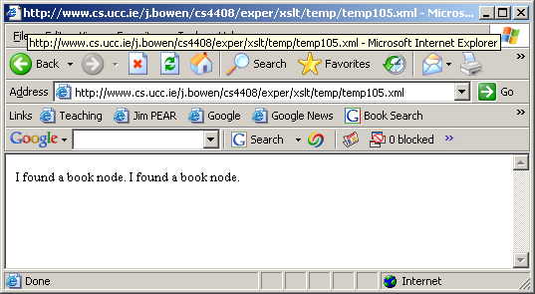
Xpath examples: locating children of the root element
<?xml version="1.0"?>
<xsl:transform version="1.0" xmlns:xsl="http://www.w3.org/1999/XSL/Transform">
<xsl:template match="/catalogue/*">
<body>I found a <xsl:value-of select="name()"/> node.</body>
</xsl:template>
</xsl:transform>

Slide 4
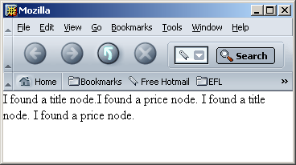
Xpath examples: locating grandchildren of the root element
<?xml version="1.0"?>
<xsl:transform version="1.0" xmlns:xsl="http://www.w3.org/1999/XSL/Transform">
<xsl:template match="/catalogue/*/*">
<body>I found a <xsl:value-of select="name()"/> node.</body>
</xsl:template>
</xsl:transform>

Slide 5
XPath paths (contd.)
As we have seen, an XPath path contains one or more "location steps", separated by slashes
So far, we have seen “location steps” which comprise simply of a tag nname or of the wild-card * character
However, in general, a location step has the following form
  axis-name::node-test[predicate]*

Slide 6
XPath axes
As noted on the previous slide, a location step in an Xpath path has the following form
  axis-name::node-test[predicate]*
An axis-name specifies a set of nodes relative to the current context node
We will see, later, that Xpath allows us to specify a wide variety of axes, or sets of nodes, relative to the current context node
The child axis is the default axis and it can be omitted -- indeed, it usually is
Thus the simplest form of location step is just a node-test
That is why the paths we have seen so far have simply involved tag-names (which are one form of node-test), separated by slashes

Slide 7
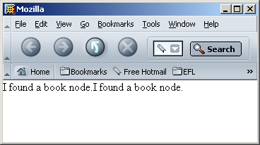
Xpath axes: the child axis
<?xml version="1.0"?>
<xsl:transform version="1.0" xmlns:xsl="http://www.w3.org/1999/XSL/Transform">
<xsl:template match="/catalogue/child::*">
<body>I found a <xsl:value-of select="name()"/> node.</body>
</xsl:template>
</xsl:transform>
Thus, /catalogue/child::* is equivalent to /catalogue/*

Slide 8
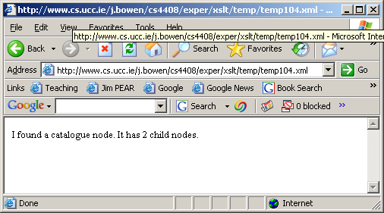
Xpath axes: the child axis -- counting children
<?xml version="1.0"?>
<xsl:transform version="1.0" xmlns:xsl="http://www.w3.org/1999/XSL/Transform">
<xsl:template match="/catalogue">
<body>I found a <xsl:value-of select="name()"/> node.
It has <xsl:value-of select="count(./child::*)"/> child nodes.</body>
</xsl:template>
</xsl:transform>

Slide 9
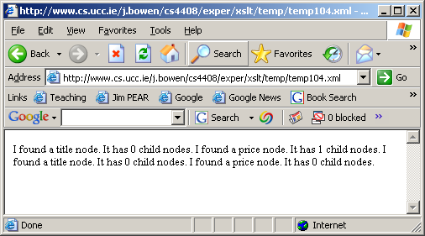
Xpath axes: the child axis -- counting children (contd.)
<?xml version="1.0"?>
<xsl:transform version="1.0" xmlns:xsl="http://www.w3.org/1999/XSL/Transform">
<xsl:template match="/catalogue/book/child::*">
<body>I found a <xsl:value-of select="name()"/> node.
It has <xsl:value-of select="count(./child::*)"/> child nodes.</body>
</xsl:template>
</xsl:transform>
Notice that atttribute nodes are not counted as children

